Slide 1
Basics
Literature search

Slide 2
Scientific information
Where can we find scientific information?
„In books“
„In journals“
„on the internet“
Quelle der Abbildungen: pixabay.com (CC0)

Slide 3
scientific Literature
There are several types of scientific literature
Some present new findings
Some summarise the current state of knowledge
Some impart basic knowledge
Some are used to look up details
Not all scientific literature is worthy to be cited!
Quelle: pixabay.com (CC0)

Slide 4
primary, secondary, tertiary
Primary literature ► current results
Research articles, specialised books
Secondary literature ► basics and state of knowledge
textbooks, reviews
Tertiary literature ► Details
encyclopaedias, reference works
Quelle: pixabay.com (CC0)

Slide 5
Fully worthy of citation
Fully worthy of citation are
Research Articles in peer reviewed journals
Scientific books
(Research) Reports
Published abstracts in proceedings of scientific conferences

Slide 6
partially worthy of citation
Partially worthy of citation are
Unpublished theses
Personal messages
Textbooks, reference works

Slide 7
never worthy of citation(?)
Never (?) worthy of citation are
Newspaper articles
Articles in popular magazines
Wikipedia
Blog posts
Personal Websites

Slide 8
Some rules
Literature that is worthy of citation meets the following criteria
Author hails from a scientific institution
has a scientific target audience
Uses technical language
Adheres to transparency and good scientific practice
Comprehensible and proper citations and reference list
Current and relevant to your own work
Notes:
substantiate = belegen

Slide 9
Approximation of Relevance
If applicable, on the basis of citation metrics
Source (for example): Web of Science
But new articles and articles in special areas might not be cited so often (yet)
The journal’s reputation, for example its impact factor
Source: Journal Citation Reports

Slide 10
reviews
Reviews summarise the current state of knowledge
They usually have extensive reference lists of primary research articles
Great starting point
If you use reviews it is never sufficient to just cite the review (though tempting…)
Always look up the referenced primary literature of a statement you want to cite
Read it, check it and cite it!

Slide 11
Wikipedia
Is it okay to cite Wikipedia?
Is it up to date?
Do you know the author’s expertise and identity?
What about online sources in general?
What should you watch out for?
Quelle: pixabay.com (CC0)
Wikipedia Logo: https://commons.wikimedia.org/w/index.php?title=File:Wikipedia-logo-v2.svg&oldid=494982984 (Lizenz: Creative Commons Attribution-Share Alike 3.0 Unported license), Trademark der Wikimedia Foundation, Inc.
15.03.2021

Slide 12
Online sources
Does it cite scientific primary literature?
If yes: get the original source, check it and cite it
If not: it’s not a good source and should not be used
Does it contain Permalinks or other persistent identifiers (DOI, PMID, etc.)?
If yes: put it in the citation/reference
If not: it’s not a good source (Why?)
Always indicate the date of your last access
Notes:
Assertion without substance

Slide 13
medical literature -Ebm pyramid
https://libguides.cmich.edu/cmed/ebm [accessed 23. August 2018]

Slide 14
Literature search

Slide 15
Parts of a search
Formulate the problem and search strategy
Search for relevant literature in suitable databases
Critically review the discovered information
Use the literature
Evaluate the process
Quelle: pixabay.com (CC0)

Slide 16
Conducting a search
1. Choose databases
2. Define search terms
3. Refine search
4. Select literature
5. Evaluate literature
6. Document search

Slide 17
Databases - overview
1. Choose databases

Slide 18
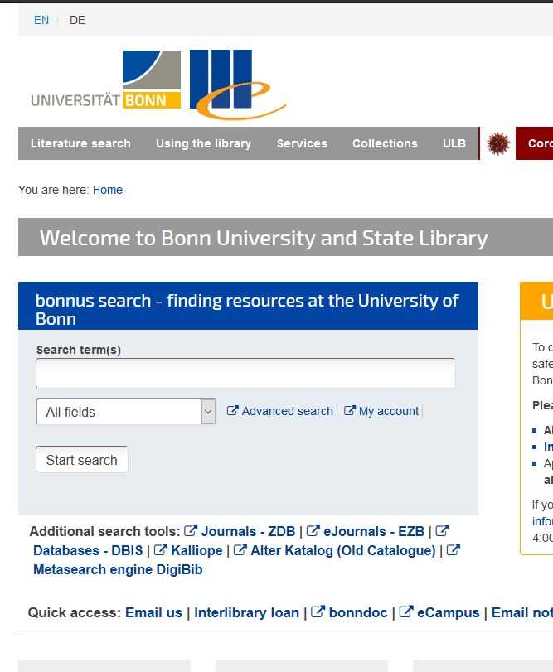
Database information system
Database Information System DBIS
Project based at the University Library of Regensburg
records all the important information on databases
participating institutions can set up an individual DBIS display -> U Bonn participates
Unfortunately only available in German …
https://www.ulb.uni-bonn.de/en?set_language=en

Slide 19
Web of science
Web of Science
interdisciplinary
Analyses more than 33.000 peer reviewed scientific journals
Reporting since 1945
Provider is also the company that publishes the Impact Factor

Slide 20
Pubmed
PubMed (https://www.ncbi.nlm.nih.gov/pubmed?otool=ideulbonnlib)
Largest and most important medical bibliographic database in the world
Published by the US National Library of Medicine
Analyses more than 5.200 journals
Non-free articles may be accessible via the library (licensed)
One part, PubMed Central, contains only Open Access articles
Notes:
Consists of medline and pubmed central

Slide 21
Livivo
Livivo (https://www.livivo.de/)
medicine, health, nutrition, and environmental and agricultural sciences
More than 58 million references to quality-controlled life sciences literature
Free of charge

Slide 22
Formulate problem & search strategy
2. Define search terms

Slide 23
search
Ideal to find
all relevant results (Recall = 1)
without irrelevant results (Precision = 1)
Precision is defined as the probability that a randomly selected relevant document is found by a specific query
Recall is defined as the probability that a randomly selected document in our results is relevant to our problem
Notes:
Unerreichbares Ideal, da eine Überpräzisierung der Suchanfrage auf eine Trefferliste, die nur noch relevante Treffer enthält, in der Regel zur Folge hat, dass nicht mehr alle relevanten Treffer enthalten sind (sozusagen als Kollateralschaden der Präzisierung).

Slide 24
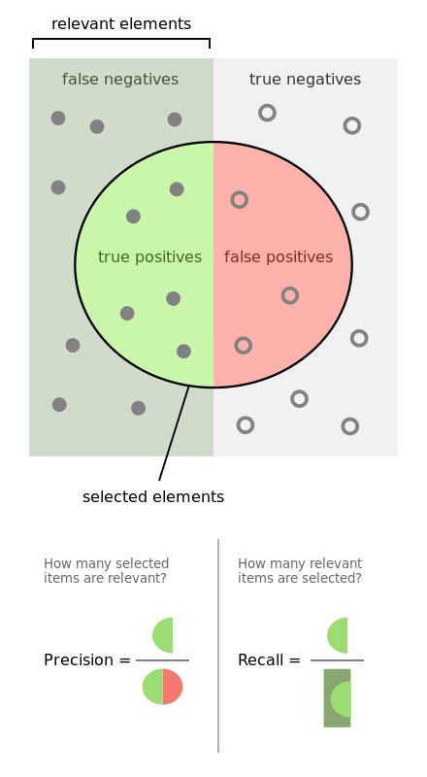
Recherche
Precision und Recall
selected elements = true positives + false positives
relevant elements = true positives + false negatives
Precision $=\frac{relevant elements \bigcap{selected elements}}{selected elements}$
Recall $=\frac{true positives\bigcap{selected elements}}{relevant elements}$
https://en.wikipedia.org/wiki/File:Precisionrecall.svg
by Walber (CC BY-SA 4.0) (accessed 26. August 2016)

Slide 25
Formulate an initial query
Choose suitable search terms
put phrases in quotation marks (“intensive care”, “drinking water supply”...)
Use terms that carry a relevant meaning
Every single term/phrase should directly relate to the problem/question
Examples for (rather) “good” search terms: hepatotoxicity, acetaminophen, amoeba
Examples for (rather) “not so good” search terms: effect, relation
pixabay.com (CC0)
Notes:
Man sollte eine Suchanfrage so stellen, dass der Bereich den sie abdeckt die gesamte Teilmenge der relevanten Treffer enthält. Diese sollte dabei aber bereits einigermaßen präzise sein. (Extremfall: Ich suche alle Einträge in der Datenbank, also befinden sich auch alle relevanten Treffer in meiner Ergebnisliste …)
Bei der Verwendung von Booleschen Operatoren ist darüber hinaus die richtige Verwendung von Klammern Voraussetzung für eine erfolgreiche Suche (siehe z.B. Hilfesektion <help> im SCIE/Web of Science). Generell sollte man sich auch stets in der Dokumentation der verwendeten Datenbank in die richtige Anwendung dieser Operatoren einlesen.
NEAR bedeutet nahe im Text (im SCIE standardmäßig 15 Worte Entfernung, d.h. NEAR entspricht NEAR/15): „Semantische Umgebungssuche“
SAME in Adresssuchen im SCIE: durch SAME verbundene Begriffe erscheinen alle im gleichen Textfeld (Suchanfrage Klammern! z. B. „OG=(University of Wurzburg)).

Slide 26
Search tools - Wildcards
A wildcard character is a placeholder that can be interpreted as a number of literal characters
Most commonly used: * (matches zero or more characters)
M*ller findet z.B. Müller, Mueller, Miller, Moeller, …
Others: ? (matches exactly one character), $ (matches zero or one character)
wom?n matches woman, women
colo$r matches colour, color
grain$ matches grain, grains

Slide 27
Different databases -Different Wildcards
Wildcards are often specific to the queried database
Information can usually be found under “Help”
e.g. PubMed allows only *, only at the end of terms
e.g. MEDLINE (Ovid) allows * ,? (as zero or one character), # (exactly one character), and $<n> (<n> characters), position: everywhere but not as the first character
Proximity Search in MEDLINE (Ovid), e.g. „neonatal adj3 unit“ matches „neonatal“ and „unit“ with up to three blanks in between, so it matches e.g. „neonatalintensivecareunit“

Slide 28
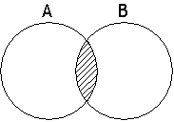
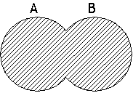
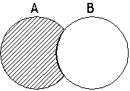
Booleans
AND: Results contain all terms (narrows the search)
acetaminophen AND hepatotoxicity
OR: Results contain at least on of the terms (broadens the search)
acetaminophen OR quinine
NOT: Term may not be included in the results
analgesics NOT opioid
Notes:
Man sollte eine Suchanfrage so stellen, dass der Bereich den sie abdeckt die gesamte Teilmenge der relevanten Treffer enthält. Diese sollte dabei aber bereits einigermaßen präzise sein. (Extremfall: Ich suche alle Einträge in der Datenbank, also befinden sich auch alle relevanten Treffer in meiner Ergebnisliste …)
Bei der Verwendung von Booleschen Operatoren ist darüber hinaus die richtige Verwendung von Klammern Voraussetzung für eine erfolgreiche Suche (siehe z.B. Hilfesektion <help> im SCIE/Web of Science). Generell sollte man sich auch stets in der Dokumentation der verwendeten Datenbank in die richtige Anwendung dieser Operatoren einlesen.
NEAR bedeutet nahe im Text (im SCIE standardmäßig 15 Worte Entfernung, d.h. NEAR entspricht NEAR/15): „Semantische Umgebungssuche“
SAME in Adresssuchen im SCIE: durch SAME verbundene Begriffe erscheinen alle im gleichen Textfeld (Suchanfrage Klammern! z. B. „OG=(University of Wurzburg)).

Slide 29
Search principles – Sensitive Search
Sensitive Search
Aim: Comprehensive search, resp. to find all relevant results
Use many search terms, synonyms, several databases
(Use OR)
Finds a large number of results, many of them not relevant
Requires time and effort to select publications
Lower probability to miss important results

Slide 30
Search principles – specific Search
Specific Search
Aim: To quickly find the most important results
Use only the most important search terms or exclusively subject headings
(Use AND)
Concentrate on specialised databases
Finds a lower number of results, many of them important
Requires lower time and effort
Higher probability to miss important results

Slide 31
Combined search
Analgesics
Acetanilide
Acetaminophen
Lidocaine
Opioid
Fentanyl
Begin with a sensitive search, specify in subsequent steps
Return to your initial sensitive results
Specify in several different ways

Slide 32
database functionalities
3. Refine search

Slide 33
Refine / expand
Too many results (i.e. too many irrelevant results)
Limit time span
Connect search terms (AND)
Use more specific terms
Too few results
Omit connections (drop search terms)
Expand time span
Use generic terms / superordinate concepts

Slide 34
Databases - Pubmed
If you access PubMed via DBIS
The utilised URL signals PubMed, that you are a member of U Bonn resp. UKBonn
So you can use the SFX-Linkingservice to check for full-texts
www.ulb.uni-bonn.de >> Datenbanken DBIS >> Fachübersicht >> Medizin >> PubMed
Or use directly the URL https://pubmed.ncbi.nlm.nih.gov/?otool=ideulbonnlib
set a bookmark there and you are set

Slide 35
Simple search

Slide 36
Simple search
First orientation
Most recent literature already in results
Can often contain less relevant results
To optimise the retrieval of relevant literature: Use the Advanced Search

Slide 37
Mesh terms
Whenever possible use MeSH Terms [MH] (Medical Subject Headings)
Standardised vocabulary (Thesaurus)
Describe the literature in terms of content
This description is done intellectually, by humans
Include e.g. synonyms or unusually expressed facts
Details to individual MeSH Terms in the MeSH Database (also as a search entry): https://www.ncbi.nlm.nih.gov/mesh
There you can also directly choose Subheadings [SH]

Slide 38
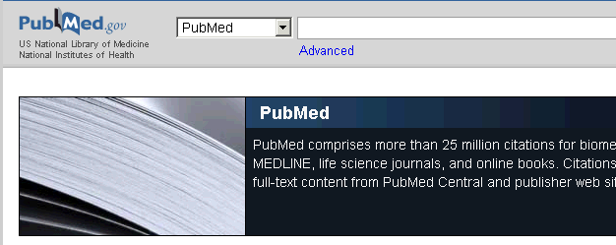
Advanced search

Slide 39
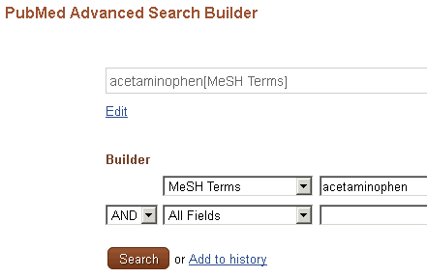
Advanced search – MeSh terms

Slide 40
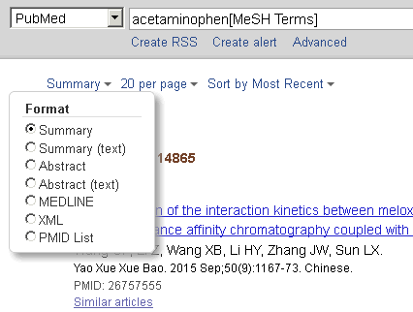
Results - Formats
There are different options to display your results.
Here: Summary

Slide 41
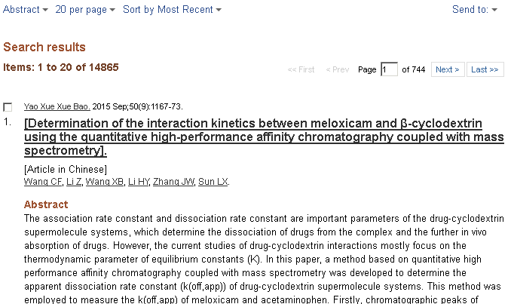
Results - abstract

Slide 42
Search history
In the Advanced Search
Search #1: Medical Subject Heading (MeSH Term) „acetaminophen“
Suchschritt # 2: Term „hepatotoxicity“ in Title or Abstract (Title/Abstract)

Slide 43
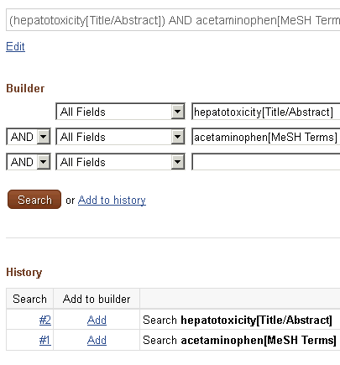
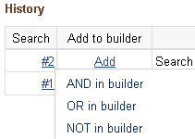
Combining searches
Search #1 and Search #2 were combined via AND.
Add #1. Click on #2 and choose option AND in builder. Click Search.

Slide 44
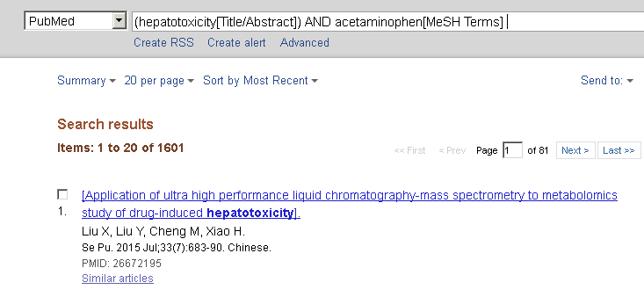
Sorting results

Slide 45
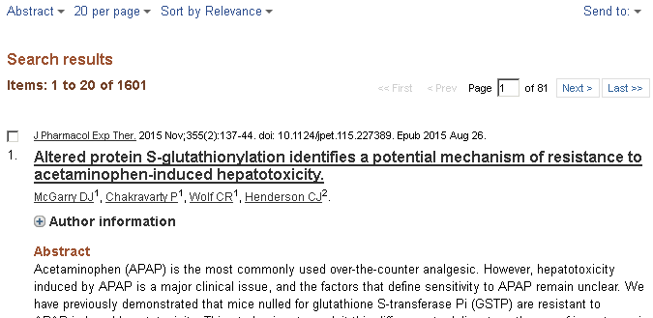
Mesh terms in results

Slide 46
My NCBI
Additional functionalities in PubMed
Requires registration
Save searches
Filter searches
Automatic alerts via e-mail if a there are new results for a saved search
Save reference lists (from results)
Use preferences, e.g. to highlight search terms in retrieved database records
My NCBI Help: https://www.ncbi.nlm.nih.gov/books/NBK3843/

Slide 47
Web of Science

Slide 48
Web of Science
Sort by date, alphabetically, times cited…
Citation Analysis
Later …
Filter options

Slide 49
Web of Science
Later…
Citation Analysis
Bibliographic Data
Further Information

Slide 50
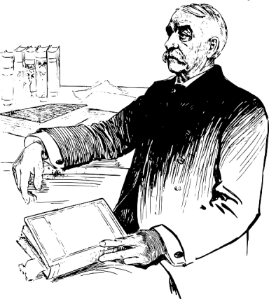
Web of science
Citation Analysis Web of Science
Source: Gantert, Klaus / Hacker, Rupert: Bibliothekarisches Grundwissen, 8. Auflage, München: K. G. Saur 2008, S. 323. (transl. D.R.)
Quelle: pixabay.com (CC0)
Article 1 1977
Article 2 1991
Article 3 1999
retrospective search
Article A 2000
cites article 3
cites article 2
cites article 1
related
articles
Article B 2002
cites article 3
cites article 2
prospective search
Article X 2005
cites article A
Article Y 2007
cites article A

Slide 51
selection, evaluation, Documentation
4., 5. and 6.

Slide 52
Literature Selection
Literature selection is done step-by-step
Preselection by Title
Selection by Abstract
Here we find a summary of the aims, methods and results
Document the number of initial results, the number of discarded results, and the number of selected results

Slide 53
Literature evaluation
Read the original article
Assess its quality
Once more assess its relevance for own work
Highlight or excerpt important information (do not forget to indicate the source!)
Creating your own summary can facilitate your research

Slide 54
Document your search
The outlined procedure should be documented
The literature search should be reproducible at all points
Steps 1 to 4 can also be documented with the help of a graphical representation (see next slide)

Slide 55
Graphic documentation
Used databases: …
Used search terms: …
articles n =
Selection via title
articles n =
Discarded results n =
Selection via abstracts
articles n =
Discarded results n =
Selection via full-text
articles n =
Discarded results n =

Slide 56
Stay up to date
Many databases offer alerting functions
These allow user to receive notifications, e.g via E-Mail, when
selected authors publish new results
saved searches yield in new results
selected publications are cited
… you often have to register an account to use these services (e.g. ‚My NCBI‘ for PubMed)
Quelle: pixabay.com (CC0)

Slide 57
Accessing full texts

Slide 58
Getting access to identified literature
Linking service SFX
Checks availability and shows the shortest path to literature
to the full extent only available inside the university network
For students and members of U Bonn also from the outside via VPN-Client or Shibboleth authentication
External users obtain only limited access to our resources
Not all databases support SFX

Slide 59
Linkingservice SFX
Full-text available
No full-text, but partly in holdings
No holdings

Slide 60
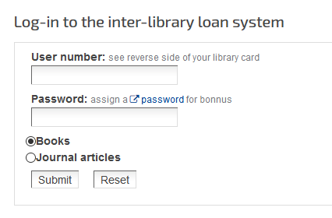
Interlibrary loan
Books as well as article copies can be ordered via interlibrary loan, provides there are no holdings in Bonn
ILL costs in most instances: 1,50€
Article copies can be kept
Information and FAQs https://www.ulb.uni-bonn.de/en/using-the-library/inter-library-loan?set_language=en

Slide 61
eJournals - EZB
Electronic Journals

Slide 62
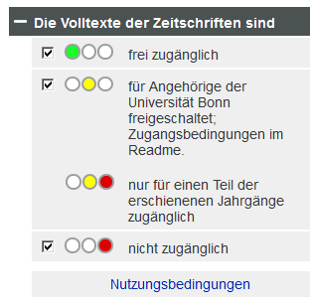
Elektronische Zeitschriftenbibliothek - EZB
Uni Bonn preset
Availability
Open Access
Uni-Net / VPN
Choose different library
No access

Slide 63
(print) Journals - ZDB
(Print) Journals

Slide 64
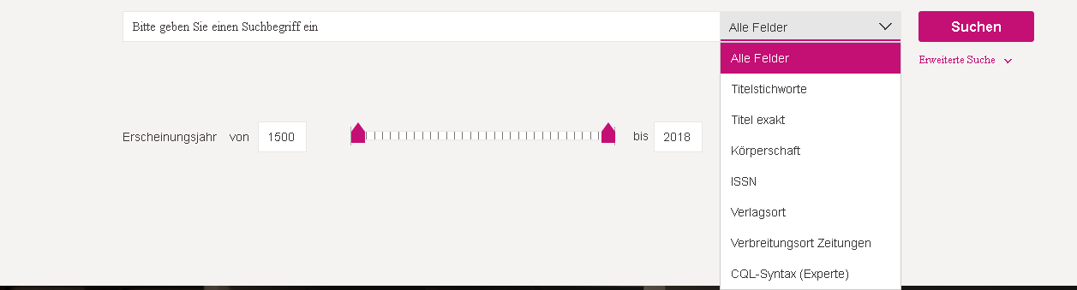
ZDB - search
All Fields: science => 32759 results
Title Keywords: science => 21481 results
Exact title: science => 67 results

Slide 65
ZDB - Besitznachweise
Library
Shelf mark
Available volumes (here: ongoing)
here: only a couple of volumes available

Slide 66
appendix: Resources
MEDLINE (Ovid) database guide
http://ospguides.ovid.com/OSPguides/medline.htm
PubMed tutorial
https://www.nlm.nih.gov/bsd/disted/pubmedtutorial/cover.html

Slide 67
Viel Erfolg!
Dr. Daniel T. Rudolf
Universitäts- und Landesbibliothek
rudolf@ulb.uni-bonn.de

